Slide 1
ML with FFT
Presented by Youssef CHAFIQUI

Slide 2
Approach
The idea is to extract features from images using FFT and to use these features for ML prediction.
To evaluate the effectiveness of the proposed approach, I have trained a list of ML models with and without FTT, and then compared the results.
Pass the whole flattened FFT matrix to the ML models (input size = image height * width)
Apply PCA to the FFT matrix with one component (input size = image height)

Slide 3
Classification: Cats vs. Dogs
 | Without FFT |  | With FFT |  | FFT and PCA
 | Accuracy | F1 score | Accuracy | F1 score | Accuracy | F1 Score
Logistic Regression | 0.38 | 0.39 | 0.63 | 0.65 | 0.61 | 0.63
SVM | 0.57 | 0.59 | 0.66 | 0.70 | 0.58 | 0.61
Random Forest | 0.5 | 0.47 | 0.65 | 0.68 | 0.58 | 0.62
XGBoost | 0.47 | 0.48 | 0.67 | 0.71 | 0.63 | 0.64

Slide 4
Regression: Age prediction from image
 | Without FFT |  |  | With FFT |  |  | FFT and PCA
 | MAE | MSE | R2 | MAE | MSE | R2 | MAE | MSE | R2
Linear Regression | 22.57 | 863.72 | -0.004 | 23.59 | 803.02 | 0.06 | 24.21 | 874.27 | -0.01
SVM | 22.89 | 842.02 | 0.02 | 23.52 | 857.02 | 0.0028 | 27.13 | 1153.5 | -0.34
XGBoost | 17.77 | 518.41 | 0.39 | 25.16 | 988.37 | -0.15 | 23.75 | 839.15 | 0.02

Slide 5
Froth flotation
 | Without FFT |  |  | With FFT |  |  | FFT and PCA
 | MAE | MSE | R2 | MAE | MSE | R2 | MEA | MSE | R2
Linear Regression
SVM
XGBoost

Slide 6
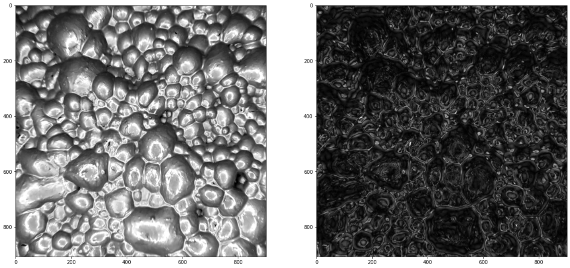
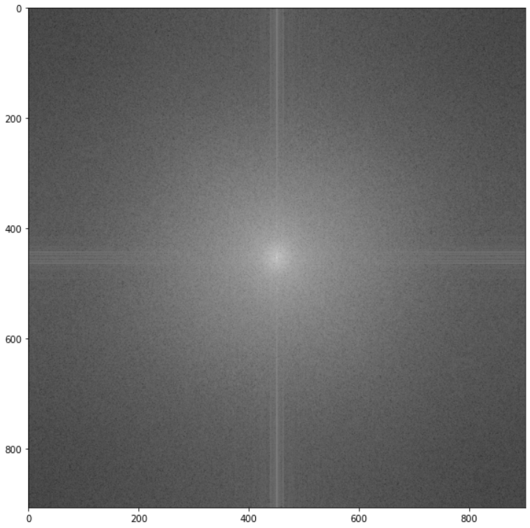

Slide 7
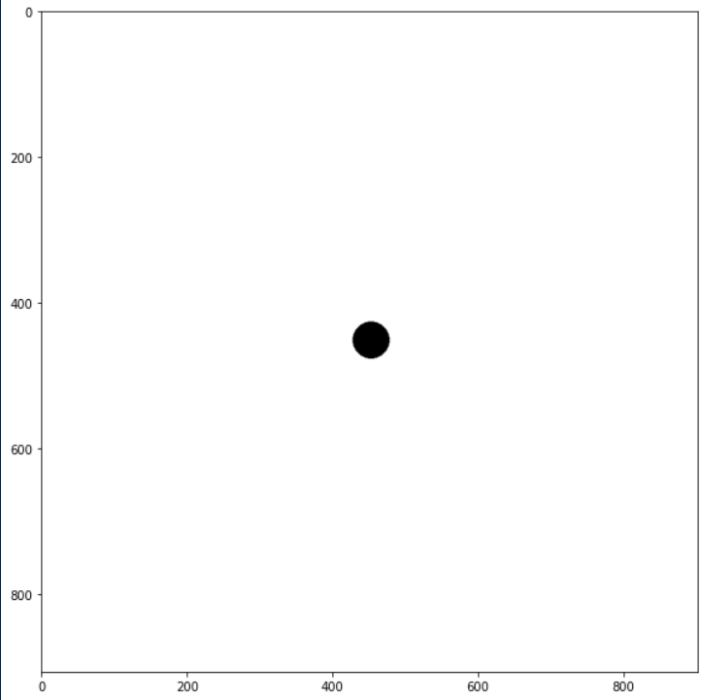
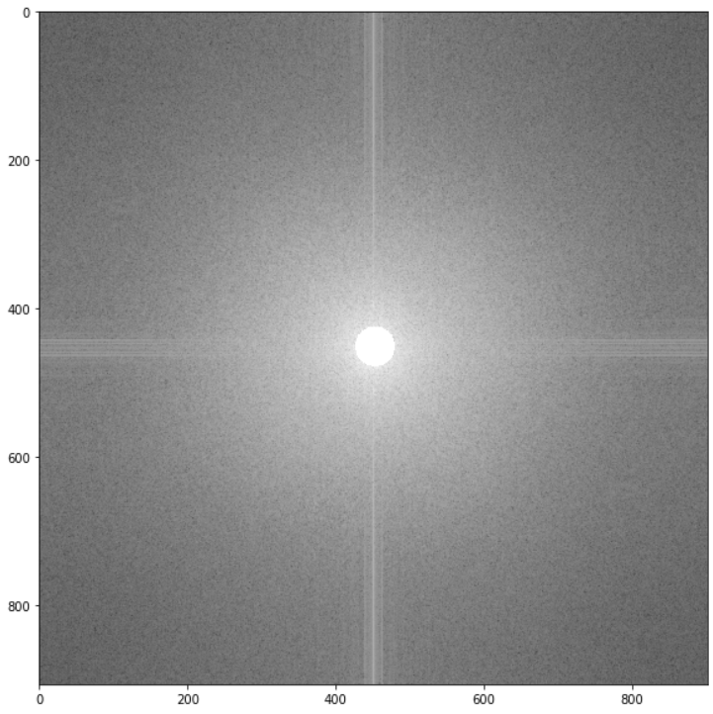

Slide 9
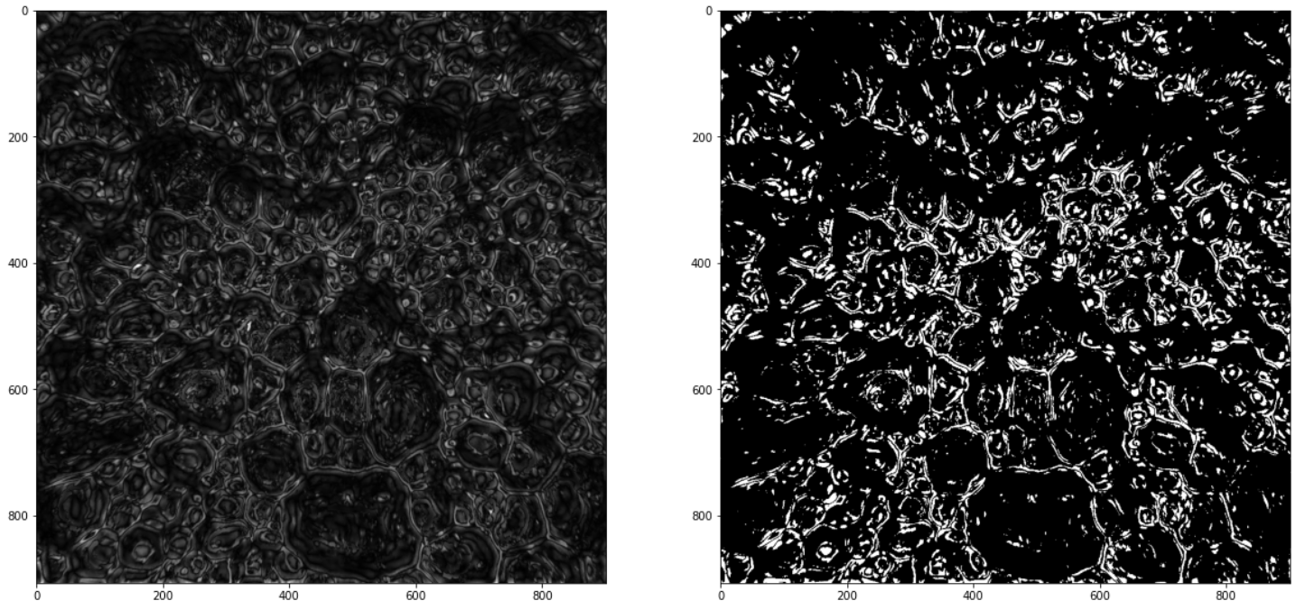

Slide 11
Thank You

